Slide 1


Slide 2



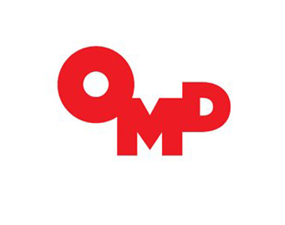



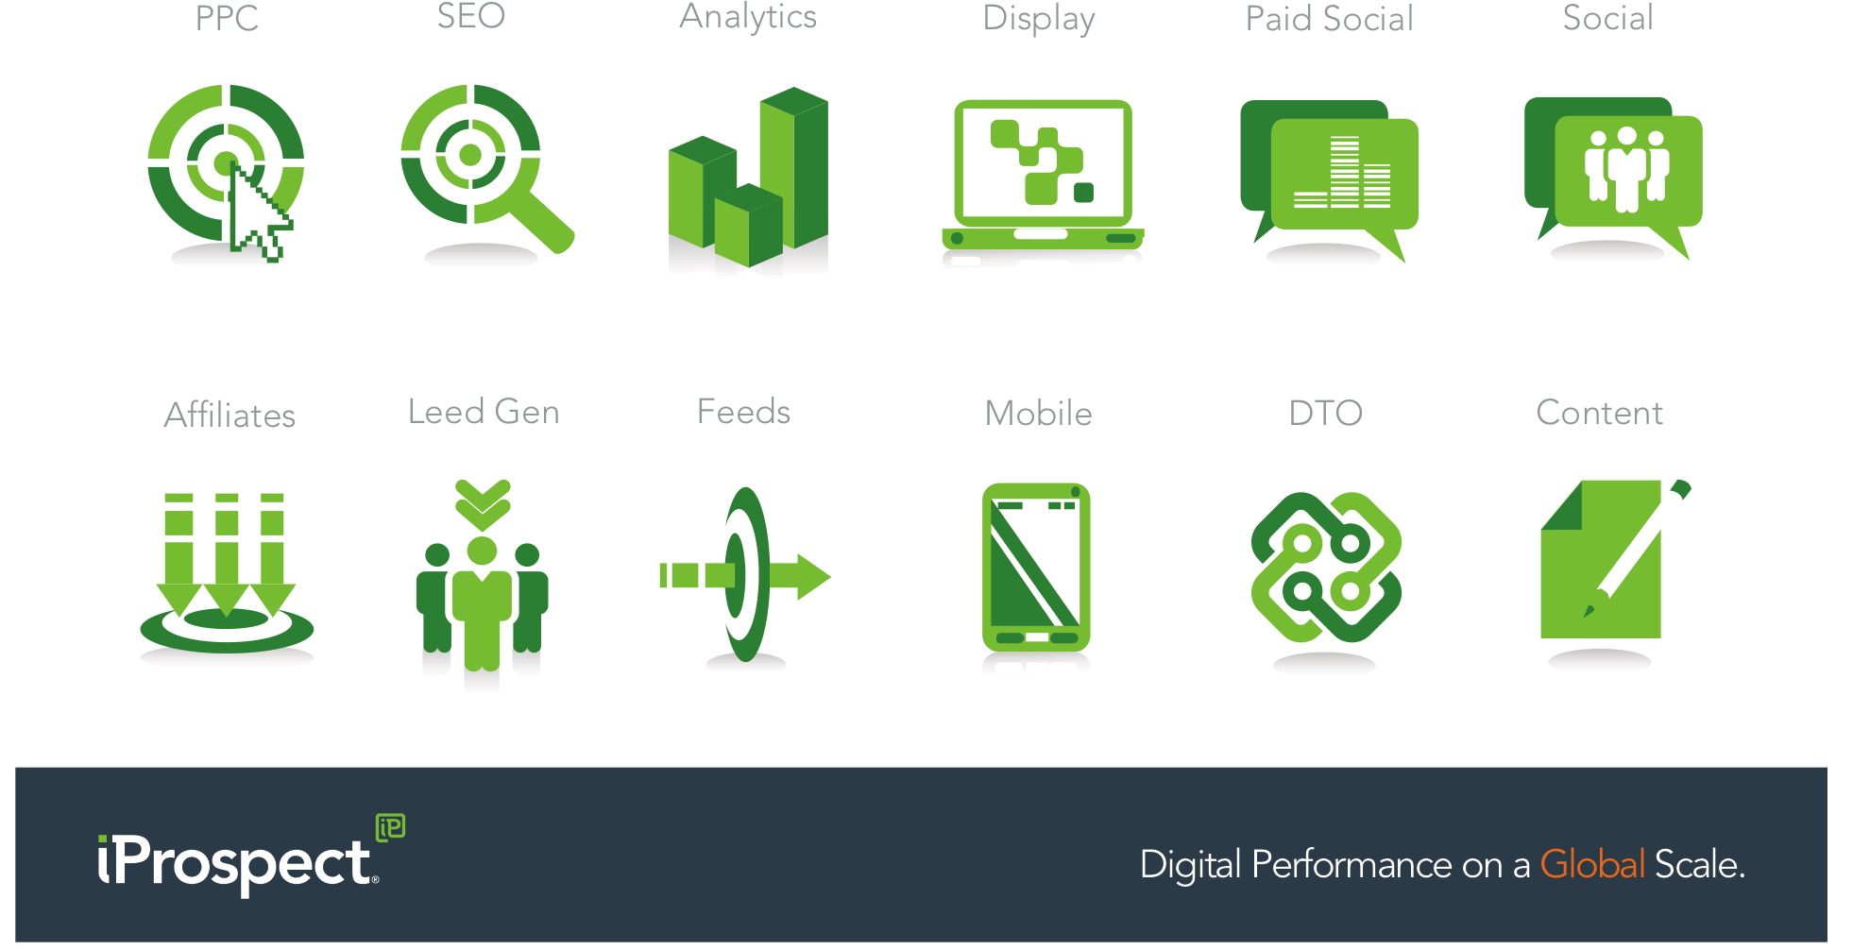
Background/Brief
Sony Ad Copy Testing
Background
iP a part of a multi-agency workshop - client wanted the EU markets to be the leader in testing and providing insights to the ROW.
PPC - best channel to perform testing due being the most efficient channel, driving the highest volume of traffic and instant results.
PPC
Creative
Display
Brief
To test brand messaging and call to actions to identify what messaging resonates with customers.
OOH

Slide 3

Strategy
Testing Matrix
Testing Strategy
Ad copy testing matrix that contained all the brand messaging that the client wanted to test - built into a testing matrix
To increase collaboration with OMD and Studio Output – workshop to identify new messaging ideas
Plan
Test
Observe
Conclude
Repeat

Slide 4

results
Testing Results
Results
Learning’s from testing shared with iP ROW and incorporated when writing ad copy.
Learning’s shared with Display and OOH agency (OMD) to use in their marketing campaigns.
OMD saw improved performance in their digital campaigns using the best performing messaging
Display

